Slide 1
The Mystery of the Vanishing Bees
By,
Michael Jones

Slide 2
Motivation and Objectives
Discovered in the late 1980s, neonicotinoid (neonics) pesticides have become the most widely used class of insecticides worldwide.
Neonics are being blamed for the loss of honeybees over the years.
Investigate the potential effects of neonics on bees since 1990 based on an open USGS data set.

Slide 3


Data
Exploration
Graph Generation
Interpretation
Data cleaning
Neonics:
CLOTHIANIDIN IMIDACLOPRID
THIAMETHOXAM ACETAMIPRID THIACLOPRID
Honey production
Number of colonies
Evaluate states
Analyze regions
Exploratory
Analysis
Determine specific compound popularity
Conclusion
Assess production and colonies

Slide 4
Platforms Language
Juypter
Powerful, versatile, shareable, and to provide the ability to perform visualization in the same environment
Python
Visualization libraries (plot.ly, matplotlib, seaborn), experience

Slide 5
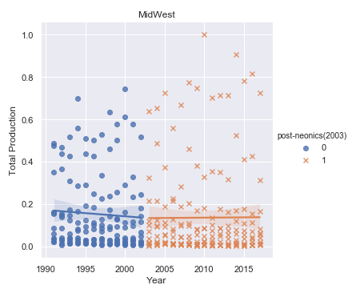
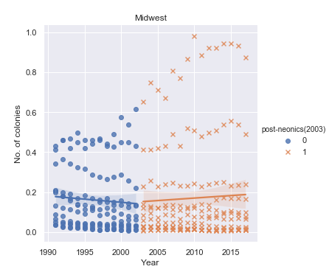
Findings
The Midwest showed a 45.5% increase of neonic usage after 2003.

Slide 6
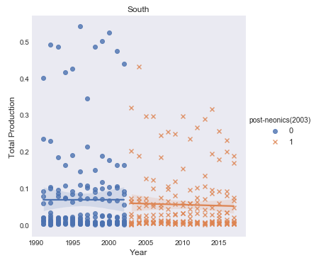
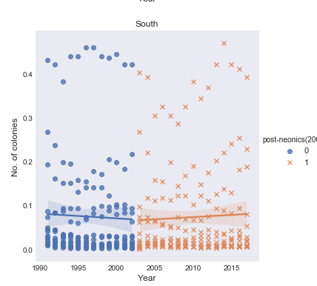
Findings (Continued)
The south was second in regards to the amount of neonics being used before and after 2003.

Slide 7
Current Status/Challenges
Generalized conclusion only, more data needed
Limited data (US only)
Other factors can be playing a role
Actual field study would be greatly beneficial
Lessons learned:
Start small, don’t get carried away
Define your problem

